Slide 1


Presented By:
Name: Wahaj Tahir & Ahmad Sattar

Slide 2
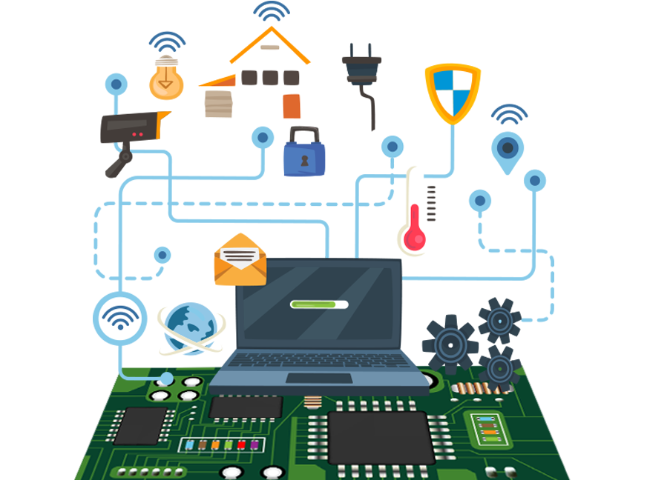
Embedded and other real-time systems projects:

Slide 3
What is Embedded System?
Embedded System:
An embedded system is a microprocessor-based computer hardware system with software that is designed to perform a dedicated function, either as an independent system or as a part of a large system. At the core is an integrated circuit designed to carry out computation for real-time operations.

Slide 4
Types of Embedded System:
1)Stand Alone Embedded System
2)Real Time system:
2.1)Soft
2.2)Hard
3)Network information appliances
4)Mobile Device

Slide 5
Stand Alone Embedded System:
It is a system that works by itself, and does not need a host system like a computer. It takes digital or analogs as inputs, and do some proccessing to them and outputs the data as it is attached to the output service.

Slide 6
Real Time system:
Real Time system:
It gives the output in a specific time, so it basically follows deadlines to complete the tasks. The following two systems are the types of Real Time system.

Slide 7
(Soft) Real Time system:
(Soft) Real Time system:
it is fine if it misses some deadlines, but it will weaken this system after several deadlines missed, so it might get worse if the number of deadlines missed increased.

Slide 8
(Hard) Real Time system:
(Hard) Real Time system:
Those systems interact usually with physical hadwares instead of interacting with a humanbeing. Violating time will effect on it so that it will cause damage or calamity.

Slide 9
Network information appliances:
Network information appliances:
It is related to network interfaces, so that it can be either in a local area (LAN), or the internet, or a wide area(WAN). It can be connected by wires or wireless.

Slide 10
Mobile Device:
Mobile Device:
The basic outline of mobile embedded systems is the memory limitation and other resources. Some examples of mobile embedded systems are most of the portable devices such as mobiles, digital cameras.

Slide 11
Prototyping:
It is process of building a model of a system.protype are employed to help system designer ,build an information system and it helps the analyst develop an initial set of system requirements.

Slide 12
Prototyping and simulation are other powerful techniques for eliciting and validating the requirements for embedded systems. Because of the costs and time needed to build hardware (and perhaps to rebuild it if you discover requirement or design errors), you can use prototypes to test operational concepts and to explore both requirements and design options for the device

Slide 13
Interfaces:
Interfaces are a critical aspect of embedded and other real-time systems. As you saw in Chapter 10, “Documenting the requirements,” the SRS should address four classes of external interface requirements: user, software, hardware, and communications interfaces

Slide 14
Time Requirement:
Timing requirements lie at the heart of real-time control systems and it is a condition or capability needed by a user to solve a problem or achieve an objective.
There are three dimensions that timing requirement involves:
time execution
latency
predictability

Slide 15
Execution time:
The execution time for a specific task is the elapsed time from when it is initiated to when it completes. This can be measured as the duration between two specific events that bound the task’s execution
latency:
Latency is the time lag between when a trigger event occurs and when the system begins to respond to it
Predictability:
Predictability is how accurately the team can estimate project timelines it refers to the repeated, consistent timing of a recurring event

Slide 16
Quality attributes for embedded systems:
Performance
Efficiency
Reliability
Robustness
Safety
Security
usability

Slide 17
Performance:
The essence of a real-time system is that its performance must satisfy the timing needs and constraints of the operating environment. Therefore, all processing deadlines for specific operations must be included in the requirements.
Efficiency:
e. Efficiency aspects of embedded systems focus on the consumption (and hence the remaining availability at any moment) of resources including processor capacity, memory, disk space, communication channels, electrical power, and network bandwidth

Slide 18
Reliability:
It is the measure of hoe much percentage you rely upon on proper functioning of your system. Mean Time between failures and Mean Time To Repair are terms used in defining system reliability.
Robustness:
Robustness has to do with how well the system responds to unexpected operating conditions
A good example of embedded systems designed for high survivability are the aircraft “black boxes,” electronic recording devices that are designed to survive the horrific trauma of an airplane crash

Slide 19
Safety:
Safety deals with the possible damage that can happen to the operating person and environment due to the breakdown of an embedded system or due to the emission of hazardous materials from the embedded products.
Security:
confidentiality, integrity and availability are three corner stone of safety.
Confidentiality deals with protection data from unauthorized disclosure
Integrity gived protection from unauthorized nodification
Availibility gives protection from unauthorized user.

Slide 20
Usability:
Usability is a quality attribute that assesses how easy user interfaces are to use. The word "usability" also refers to methods for improving ease-of-use during the design process. Usability is defined by 5 quality components: Audio acuity and frequency response (consider when designing audio feedback and prompts). ■ Visual acuity and color vision (consider the use of color and text size in visual displays). ■ Handedness and manual dexterity (affects the user’s ability to press small buttons accurately or to navigate using a touch screen). ■ Body size and reach (keep the user profile in mind when establishing the physical positioning of controls, displays, and equipment). ■ Native languages (important for devices controlled by speech recognition)

Slide 21
There are four aspect that how system handle fault:
Fault prevention:
Ideally, the system will prevent many potential fault conditions before they can cause a failure. That’s the idea behind having software systems test preconditions before initiating the execution of a use case
Fault detection:
The next-best course of action is to detect a fault as soon as it occurs. This is why requirements elicitation must explore exception conditions, so developers can anticipate possible errors and devise ways to look for them.

Slide 22
Fault recovery:
If the system detects an anticipated fault, it should have mechanisms defined for responding to it.
Fault logging:
The system should retain a history of faults that it detects and what happened as a consequence. This information is useful for diagnosing what’s wrong and can help a maintenance person detect patterns that lead to problems.

Slide 23

ANY QUESTIONS?

Slide 24
THANK YOU

